Slide 1

Introduction to WebRTC
Luis López
lulop@kurento.org
http://www.kurento.org

Slide 2





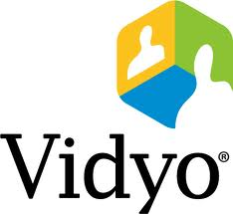







Real-time Communications (RTC)
Internet RTC
Fragmentation
No universal RTC service
Telco RTC
Standardization
Phone system as universal RTC service

Slide 3
WebRTC: a new player
WebRTC: a definition
WebRTC as a framework
Technological capabilities enabling RTC on web browsers: Codecs, NAT traversal, security, transports, etc.
Framework, protocol and API that provide real-time voice, video and data in web browsers and other applications (by Salvatore Loreto)
WebRTC as an API
Capabilities are exposed to web developers in an abstract manner and adapting to HTML5 philosophy
Basing on standards: RTCWeb Working Group of the IETF for protocols
Basing on standards: WebRTC Working Group of the W3C for JavaScript APIs

Slide 4
Why WebRTC
Other
Telco
Skype
WWW
RTC as a feature
Dev. tools
Dev. Community
Universal

Slide 5
Why WebRTC
Plug-in
Silverlight
Flash
WebRTC
Openness
Standards
No installs
Smartphones

Slide 6
















Who is who in WebRTC

Slide 7
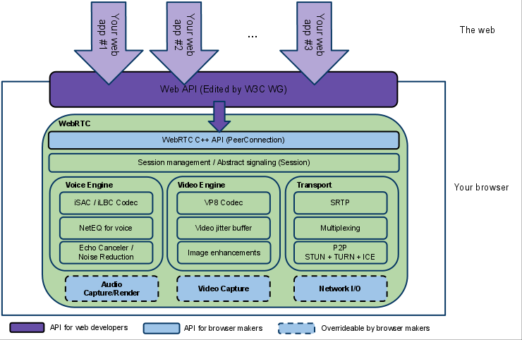
What’s WebRTC: browser architecture
*This image has been borrowed from: http://www.html5rocks.com/en/tutorials/webrtc/basics/

Slide 8
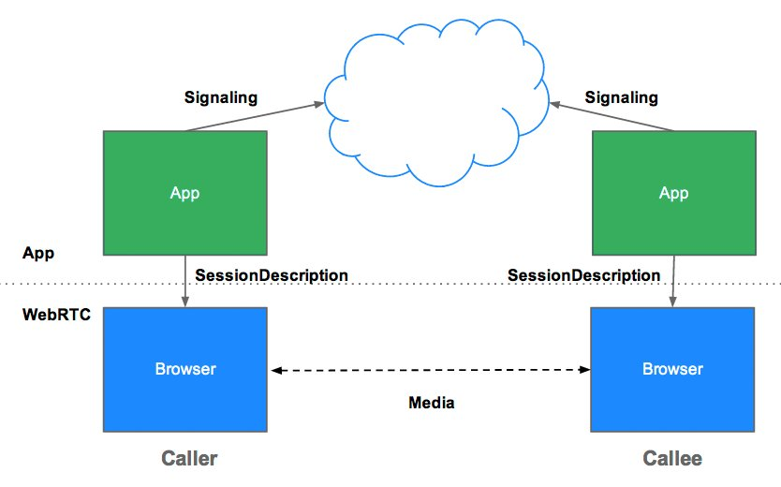
WebRTC: P2P communications
*This image has been borrowed from: http://www.html5rocks.com/en/tutorials/webrtc/basics/

Slide 9
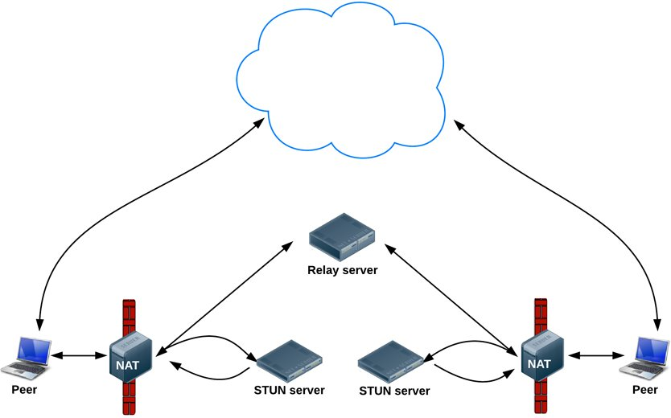
WebRTC: NATs
*This image has been borrowed from: http://www.html5rocks.com/en/tutorials/webrtc/basics/
http://io13webrtc.appspot.com/#44

Slide 10
Developing WebRTC apps
http://io13webrtc.appspot.com/#9
http://www.html5rocks.com/en/tutorials/webrtc/basics/

Slide 11
Example
https://talky.io/
https://www.cubeslam.com

Slide 12
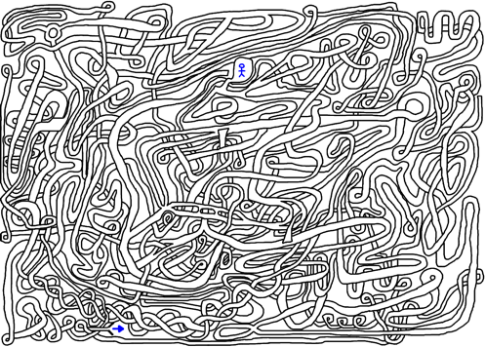


Why Kurento?
WWW RTC developer experience
Before WebRTC
After WebRTC
Next natural step…
Developing
the client side
Begin
End
Begin
End
Unified APIs
Standards
FOSS
Multiplatform
Unified APIs
Standards
FOSS
Multiplatform
Developing the
infrastructure
side
Begin
End
Unified APIs
Standards
FOSS
Multiplatform

Slide 13
Kurento media framework components
Kurento Media Server
Low level media capabilities
Transport, encode/decode, transcode, CV, mix, etc
C/C++
C++ Media Server + Gstreamer plugins
Kurento Application Server
Signaling and control capabilities
SIP, HTTP, RESFul, etc.
Java
Spring + JBoss + Mobicents SIP Servlet
Kurento WWW SDK
HTML5 multimedia development
Video tag, WebRTC
Javascript
Kurento Android SDK
RTC library for Android
Java and C
Multicodec support

Slide 14

Kurento Application Server: extending the WWW development model
HTTP request:
I want this resource
Signaling request:
I want this media
Process WWW request
DDBB access
Transactions
Security tools
Etc.
Process media request
Media API
DDBB access
Transactions
Security tools
Etc.
HTTP response:
The resource
Signaling response:
The media is here
Intuition behind
traditional WWW
Applications
(Servlets, ASP, PHP,
Rails, etc.)
Intuition behind
Kurento
development APIs:
Multimedia RTC is just another feature of your application

Slide 15



Media API: media elements and media pipelines
Media Element
  Provides a specific media functionality
    Building block
    Send/receive media
    Process media
    Transform media
  The Media API provides a toolbox of media elements ready to be used.
  New media elements can be added
Media pipeline
  Chain of media elements implementing the desired media functionality.
  The Media API provides the capability of creating media pipelines by joining media elements of the toolbox
Media Element
PlayerEndPoint
WebRtcEndPoint
Filter
Sink
SRC
SRC
Sink
SRC
Sink

Slide 16



Application architecture
Other systems
and databases
Signaling and
WWW traffic
Signaling and
WWW traffic
Media
Media
HTTP
Servlet
SIP Servlet
Web services
DD.BB.
JMS
Java EE compatible container
Specific application logic
Media API
Decode
Video
Augmented
Reality
Video Playing
and Recording
Computer
Vision
Encode
Video
Kurento Media Server Infrastructure

Slide 17

Possible use cases: just integrate with Java EE and GStreamer
Verticals
  E-Health
    Kurento + HAPI (http://hl7api.sourceforge.net/)
      P2D video conferences as Electronic Health Records
  Smart cities
    Kurento + NGSI + OpenCV + Google Maps
      City crowds movement tracking
      Traffic density tracking
Telco infrastructures
  Kurento + Mobicents
    IMS application server
B2B & B2C WWW RTC
  Kurento + CRM APIs
    Enriched video conferencing with customer personal data
  Kurento + ESB
    Billing, video event processing, physical security, etc.

Slide 18
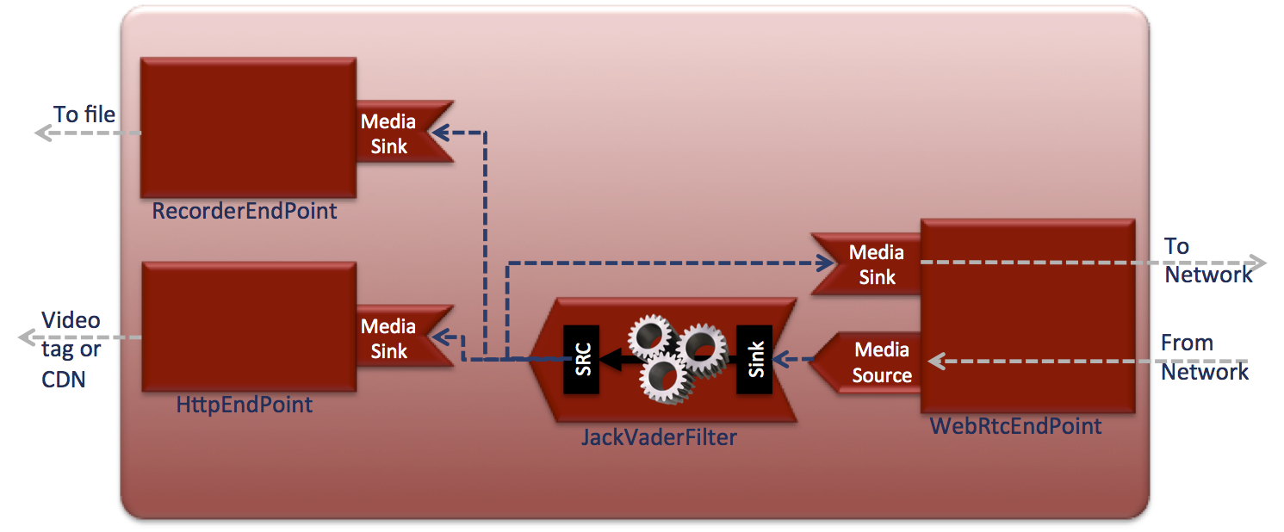


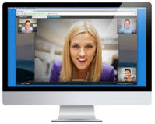



Application example: requirements
Kurento Media Server Infrastructure

Slide 19



Application example: code
@WebRtcMediaService(name = "MyWebRtcService", path = "/pathToService")
public class MyWebRtcService implements WebRtcMediaHandler {
public void onMediaRequest(WebRtcMediaRequest request) {
//I can authenticate using any of the Java EE available mechanisms
MediaPipelineFactory mpf = request.getMediaPipelineFactory();
MediaPipeline mp = mpf.createMediaPipeline();
//I could decide the type of processing connecting to a DDBB
JackVaderFilter filter = mp.newFilter().withType(JackVaderFilter.class).build();
RecorderEndpoint recorder = mp.newRecorderEndpoint().withUri("file:///myFile.webm");
filter.connect(recorder);
HttpEndpoint httpEndpoint = mp.newHttpEndpoint().build();
filter.connect(filter); //I could connect only audio or video separately
request.startMedia(filter, filter);
}
To file
Media
Sink
RecorderEndpoint
Media
Sink
To
Network
Video
tag or
CDN
Media
Sink
Media
Source
From
network
SRC
Sink
HttpEndpoint
JackVaderFilter
WebRtcEndpoint

Slide 20

Application example: result

Slide 21

Media element toolbox
Transport
WebRtcEndpoint
RtpEndpoint
HttpEndpoint
Repository
PlayerEndPoint
RecorderEndPoint
Group communications
MainMixer
GridMixer
RoundRobinMixer
Filters
FaceRecognitionFilter (events)
JackVaderFilter
QR/Barcode detector
PlateRecognitionFilter (events)
ColorTrackingFilter (events)
And growing …
Available as part of

Slide 22
Media elements: WebRtcEndpoint
Full implementation of the RTCWeb protocol stack
  SRTP
  ICE
  DTLS
Allow sending and receiving WebRTC flows at the media server infrastructure
WebRTC traffic
Media
Source
WebRTC traffic
Media
Sink
WebRtcEndpoint

Slide 23
Media elements: HttpEndpoint
Media downloading compatible with the HTML5 video tag
  WebM (Chrome, Firefox)
  MP4 (Chrome, Firefox, IE, Safari)
Media uploading compatible with HTML file input tag
  Multipart support
HTTP WebM/MP4
Media
Sink
HttpEndpoint

Slide 24

Media elements: RtpEndpoint
Full-duplex RTP multimedia exchange
  H.264
  H.263
  VP8
  Many different audio codecs supported
RTP traffic
Media
Source
RTP traffic
Media
Sink
RtpEndpoint

Slide 25

Media elements: UriEndpoints
PayerEndpoint
  Play media from file or URL
    Support for most popular formats
RecorderEndpoint
  Record media to file or URL
    WebM
    MP4
Media
Sink
RecorderEndpoint
Media
Source
PlayerEndpoint

Slide 26

Media elements: Mixers (in progress)
Make possible group communications
  ForwardingMixer
    One-to-many replication of flows
    A source can be assigned to any of the sinks
    Multiple sources supported
  MainMixer
    Mixes media
    A source can be assigned to a combination of sinks
    Multiple sources supported
Media
Source
Media
Sink
Media
Source
Media
Sink
Mixer
Media
Sink
Media
Source

Slide 27
Filters
Seamless integration into OpenCV
  Face recognition
  Augmented reality
  Subtitle adding
  Color manipulation
  QR detection
  People counter
  Plate recognition
  Etc.
Filter
Sink
SRC

Slide 28

Filter with events
Filters can provide events to the application
  Events are generated at the media server
  Events can be propagated to the client app
Code example:
MediaPipeline mp = mpf.create();
PlayerEndPoint playerEndPoint = mp.newPlayerEndPoint(
"https://ci.kurento.com/video/barcodes.webm").build();
ZBarFilter filter = mp.newZBarFilter().build();
playerEndPoint.connect(filter);
filter.addCodeFoundDataListener(new MediaEventListener<CodeFoundEvent>() {
@Override
public void onEvent(CodeFoundEvent event) {
session.publishEvent(new ContentEvent(event.getType(),
event.getValue()));
...
Events
Media
Source
Sink
SRC
PlayerEndpoint
ZBarFilter

Slide 29
The magic of pipelines: Transparent media adaptation
Agnostic media adaptor
  Acts every time a source is connected to a sink
  Adapts media formats as required by the involved media elements
  100% transparent for the application developer
An agnostic media adaptor is “hidden” behind every connection making compatible element formats transparently
Media Element
Media Element
VP8
H.264
Sink
SRC
Sink
SRC

Slide 30
Complex examples: Heterogeneous group communications
Media
Source
Media
Sink
Media
Sink
RecorderEndpoint
WebRtcEndpoint
Media
Source
Media
Sink
Mixer
WebRtcEndpoint
Media
Source
Filter
Media
Sink
Sink
SRC
RtpEndpoint

Slide 31
Complex examples: WebRTC to HTTP
Media
Source
Media
Sink
Media
Sink
RecorderEndpoint
WebRtcEndpoint
Mixer
Media
Sink
HttpEndpoint
Mixer
Media
Sink
HttpEndpoint
Media
Sink
HttpEndpoint

Slide 32
Complex examples: WebRTC Playing
Media
Source
Media
Sink
Media
Sink
RecorderEndpoint
WebRtcEndpoint
Mixer
Media
Sink
Filter
HttpEndpoint
Sink
SRC
Media
Source
PlayerEndpoint

Slide 33




WebRTC CV game
http://www.youtube.com/watch?v=CRqT7Q9KkRY
ChromaFilter
FaceOverlayFilter
Sink
SRC
Sink
SRC
Sink
SRC
Sink
SRC
WebRtcEndpoint
MirrorFilter
PointerDetectorFilter
WebRTC full
duplex client
video application
SRC
Sink
Upload to
Youtube
Sink
Media Pipeline

Slide 34
Collaborations welcome http://www.github.com/kurento
Thank you very much for your attention
Complains, suggestions and comments can be sent to:
Luis López
lulop@kurento.org

